Slide 1
SCC211 Revision
Zhang Jinyu – zjy@bjtu.edu.cn
School of Computer and Information Technology
SD412

Slide 2
Examination
SCC.211 Module
60% Exam + 40% Coursework

Slide 3
SCC211 Exam
30 Conception + 40 Practice
Conception
8 questions, each 4 marks except for one ( 2 marks).
Practice
Spurious Wakeup(10 marks)
Mutex (10 marks)
Semphore (10 marks)
Process schedule (10 marks)

Slide 4
[Conception]

Slide 5
Typical Question
1 What is the shared resources among multiple processes? [4 Marks]
Answer:
- Memory (global, heap) [2 Marks]
- Hardware devices [2 Marks]

Slide 6
Typical Question
2 When a dead lock is detected, how to recover it? [4 Marks]
Answer:
– Selectively abort processes [2 Mark]
– Roll back to an earlier state [2 Mark]

Slide 7
Typical Question
3 What does the context of a process contains? [5 Marks]
Answer: (more than four out of six are given 4 Marks)
Contents of CPU registers [1 Mark]
Memory map [1 Mark]
Open files [1 Mark]
On-going communication [1 Mark]
Configured timers or alarms [1 Mark]
Accounting info. / Resource usage [1 Mark]

Slide 8
Typical Question
4 In memory allocation, what is the benefit of “paging”? [5 Marks]
Answer: (more than two out of three are given 4 Marks)
Simplifies allocation [2 Marks]
A process only needs entries for the memory it uses [2 Marks]
A virtual page can (in theory) be mapped to ANY physical frame [2 Marks]

Slide 9
Typical Question
5 Which problem may occur in priority-based scheduler? [4 Marks]
Answer:
A process will ‘starve’ in situations where there is always a runnable process with higher priority. [4 Mark]

Slide 10
Typical Question
6 Recover the following dead lock. [4 Marks]
Lock1.acquire()
Lock2.acquire()
Lock1.release()
Lock2.release()
Answer:
Lock1.acquire()
Lock2.acquire()
Lock2.release()
Lock1.release()

Slide 11
Typical Question
7 Describe the task of device driver? [4 Marks]
Answer:
I/O Scheduling . [1 Mark]
Buffering, Spooling and Caching [1 Mark]
Error Handling [1 Mark]
I/O Protection [1 Mark]

Slide 12
Typical Question
8 What is difference between process and thread? [4 Marks]
Answer:
[2 mark ] Process is allocated independent address apace.
Usually operate on different tasks
Heavier-weight Context switch; support thick-grained concurrency
[2 mark]Threads share a common address space
Can easily cooperate on common tasks
Lighter-weight switch; support fine-grained concurrency

Slide 13
[Practice]

Slide 14
Typical Question
1 How many processes are created when executing this program?
Answer:
int main() {
int i;
for(i=0; i<n; i++) fork();
}
Answer:
2^{n}-1.

Slide 15
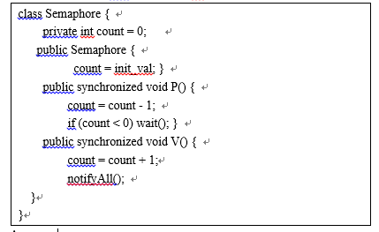
Typical Question
2 Use following Class Semaphore to implement the mutual exclusive method public void put() and public int get() in Class Dimension.

Slide 16
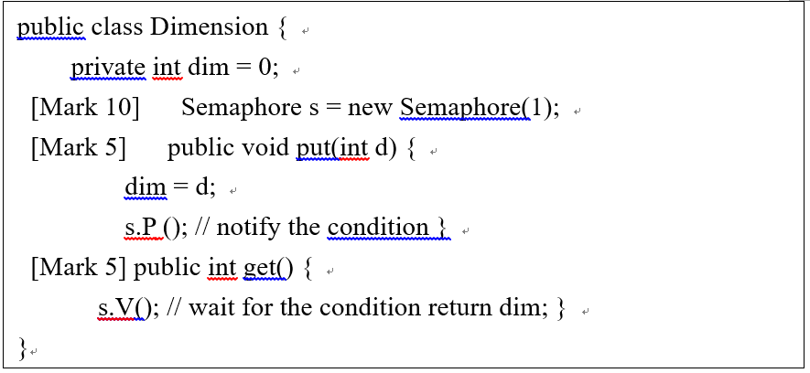
Answer:

Slide 17
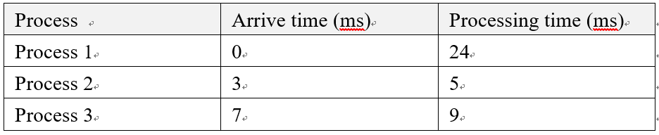
Typical Question
3 Three processes are scheduled according to Round Robin (RR) with quantum=4ms.
Task: calculated the average Turnaround Time (complete time-start time).

Slide 18
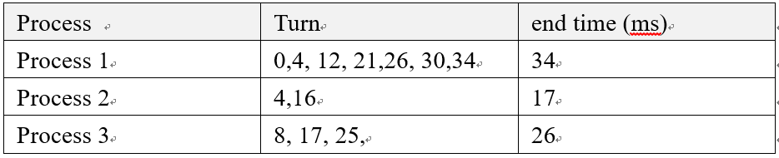
Answer:
The Turnaround Time: [5 Marks]
Process 1: 34-0=34
Process 2: 17-3=14
Process 3: 26-7=19
The average waiting time=(34+14+19)/3=67/3=22.3(ms) [5 Marks]

Slide 19
Question？

